Slide 1
Say what not how
Introduction to Functional Programming

Slide 2
Agenda What’s In, What’s Out
I (and many others) started with Imperative programming; Functional programming is a kind of Declarative programming – so what’s what?
Focus on higher order functions – a grounded and common way to do functional programming. (We will ignore the kind that return functions)
Avoiding everything else; I’m not qualified on that, and we only have so much time

Slide 4
Imperative Example Say How to Do It
Create a new empty list to hold the result (lets call it result list)
Accept the list of all customers and iterate through the list.
For each customer, check for these two conditions:
Check their address and verify they live in Kansas City
Check if the customer has spent over 100 dollars
If the above criteria is met, add the customer to the result list
If the above criteria is not met, then do not add the customer to the result list
After going through all customers, return the the result list

Slide 5
Imperative Example Say How to Do It
function CustomerReport(customers, city, amountSpentRequired){
let result = [];
for(let i = 0; i < customers.length; i++){
let customer = customers[i];
if(customer.address.city === city &&
customer.amountSpent >= amountSpentRequired)
result.push(customer)
}
return result;
}
let resultI = CustomerReport(allCustomers, 'KC', 100);

Slide 6
Declarative Example Say What To Do
I want all customers that live in Kansas City and have spent over 100 dollars.
let result = allCustomers
.filter(x => x.address.city === 'KC’ && x.amountSpent > 100 )

Slide 8
.Filter? What? Yo Dog, I Heard You Like Functions
Filter is a Higher Order function in JavaScript
For each element in the array it is called on, it executes the function passed in; if true it saves element: if not, discards the element.*
So we don’t worry about looping, storing intermediary results, or returning anything; we just focus on the logic we do care about.
*Technically a brand new list is created, because immutability

Slide 9
But what about “x =>” Nothing more than shorthand
In JavaScript, doing “x =>” is just shorthand for declaring an anonymous function (called fat arrow syntax)
allCustomers.filter(
function(customer)
{
return customer.address.city === ‘KC’ && customer.amountSpent > 100
}
)

Slide 10
But Why Fat Arrow Syntax? Complexity over simplicity?
In my experience, many JavaScript examples use the fat arrow syntax over longhand syntax.
Opinion: When I started, it felt intimidating to look at. Once I got it, I felt it it was more readable, reducing clutter and expressing the code I cared about

Slide 11
But why care about readable code? What does ‘expressive’ code mean?
“Indeed, the ratio of time spent reading versus writing is well over 10 to 1. We are constantly reading old code as part of the effort to write new code. ...[Therefore,] making it easy to read makes it easier to write.”
- Robert C. Martin, Clean Code: A Handbook of Agile Software Craftsmanship

Slide 12
Map, Reduce, Filter The Trifecta
Map
Filter
Reduce
Not just built in functions – key higher order functions found in lots of languages

Slide 14
Filter Operator Use when you want to pick data
function onlyTallEnough(heights, minHeight){
let result = [];
for(let i = 0; i < heights.length; i++){
let height = heights[i]
if(height >= minHeight)
result.push(height)
}
return result;
}
let result = heights.filter(x => x >= 4.25);

Slide 16
Map Operator Use when you want to change data
function getCities(customers){
var result = [];
for(var i = 0; i < customers.length; i++){
var customer = customers[i];
result.add(customer.address.city)
}
return result;
}
var result = customers.map(x => x.address.city);

Slide 18
Reduce Operator Use when you want a tally of data
function calculateSpent(customer) {
let total = 0
for (let i = 0; i < customer.purchases.length; i++) {
let purchase = customer.purchases[i];
total = purchase.amount + total;
}
return total;
}
let total = customer.purchases
.reduce((total, x) => total = x.amount + total, 0);

Slide 19
All Together Now Say we didn’t customer.amountSpent And we now only want Customer IDs
function CustomerReport(customers, city, amountSpentRequired) {
let result = [];
for (let i = 0; i < customers.length; i++) {
let customer = customers[i];
if (customer.address.city === city) {
let amountSpent = 0;
for (let i = 0; i < customer.purchases.length; i++) {
let purchase = customer.purchases[i];
amountSpent = purchase.amount + amountSpent;
}
if (amountSpent >= amountSpentRequired)
result.push(customer.customerId)
}
}
return result;
}

Slide 20
All Together Now Now using Map, Filter, Reduce
let resultD = allCustomers
.filter(x => x.address.city === 'KC')
.filter(x => x.purchases
.reduce((total, x) => total = total + x.amount, 0) >= 100)
.map(x => x.customerId);
Instead of imperative code cluttering the code, taking a more functional approach puts the logic we care about front and center

Slide 21
In Summary Because we’ve covered a lot
Functional Programming is a kind of Declarative Programming – which wants to express what to do by using higher order functions
Higher order functions either return a function (not covered) or take a function; by taking a function, they can abstract away logic we can ignore
By using Map, Filter, & Reduce, we can express and focus on the meaningful (business) logic

Slide 22
But What, There’s More Because there’s a million more things
To list a few (far from everything):
Functors, Applicatives, Monads, and all the other Mathematical Theory that Functional Programming is based on
Data Immutability (plus parallelism benefits)
Function Composition
Lazy Evaluation
A Million Other Things

Slide 23
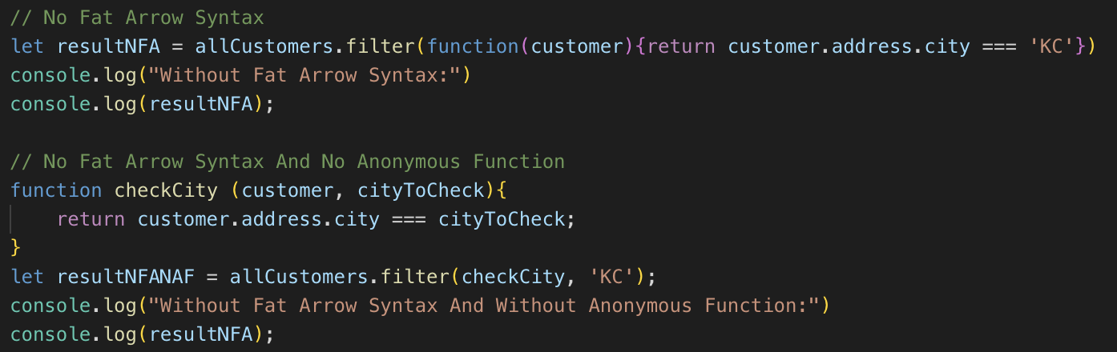
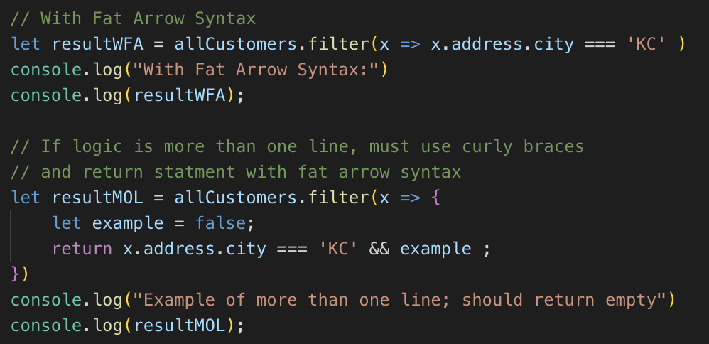
Thank You – Questions?
For the slides & code examples, see:
https://github.com/noah-dev/talk_say_what_not_how

